Slide 1
Yancarlo B
LLM code prompt and comparison

Slide 2
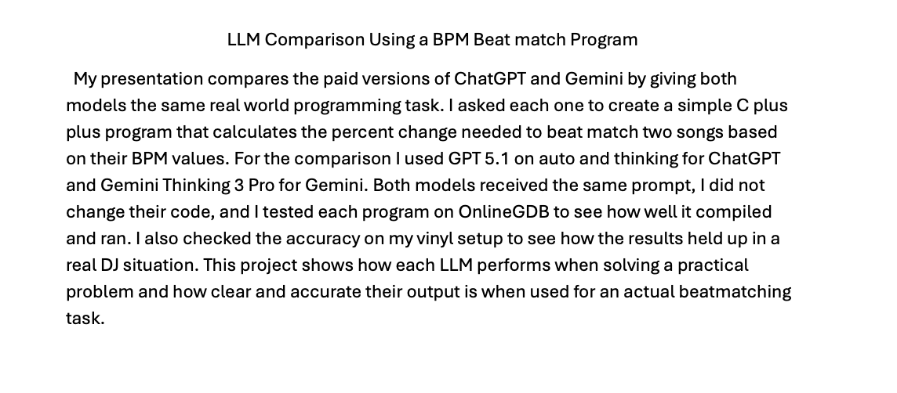
The Project

Slide 3
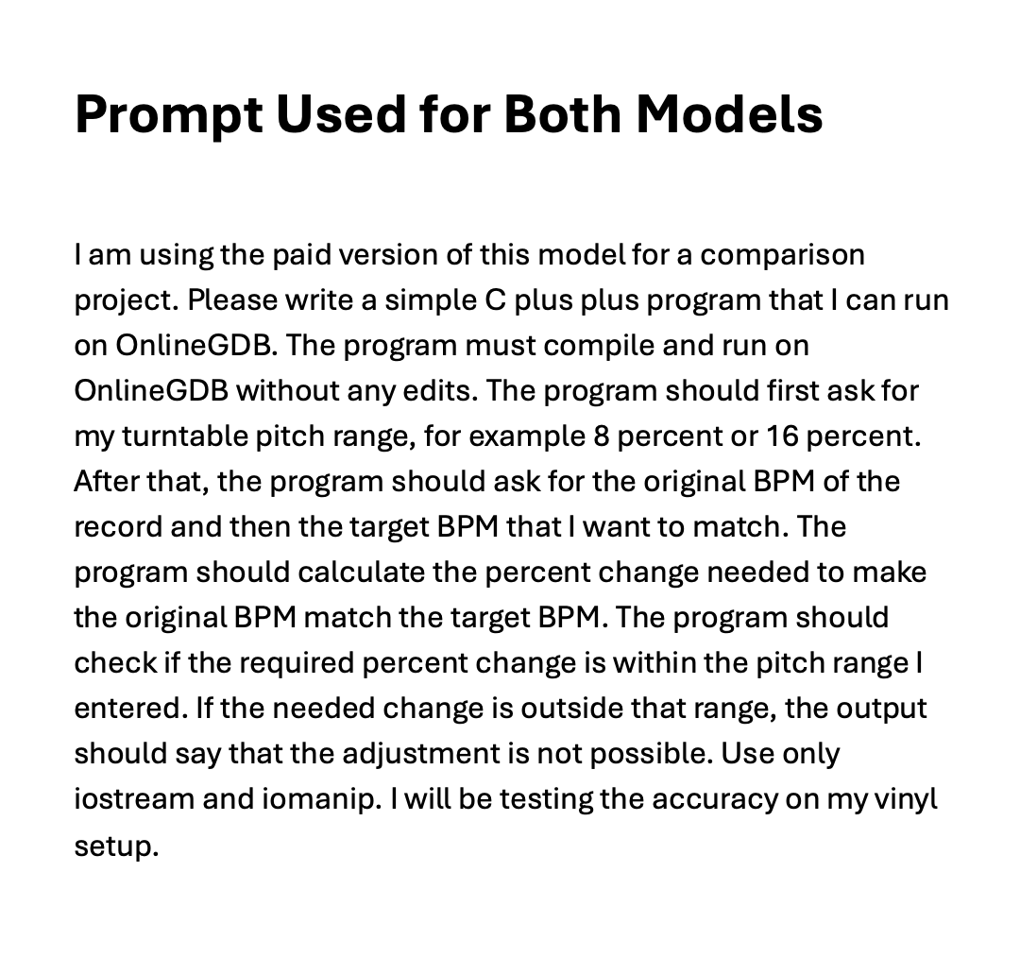
The prompt Used to Test both Models

Slide 4
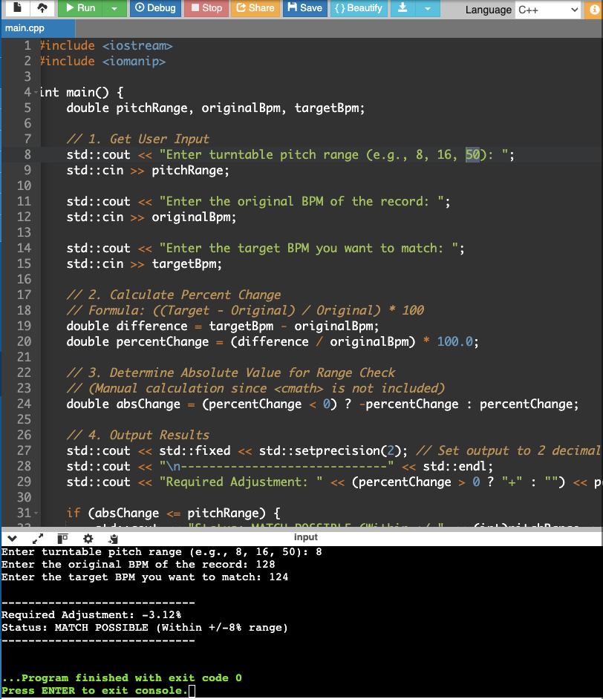
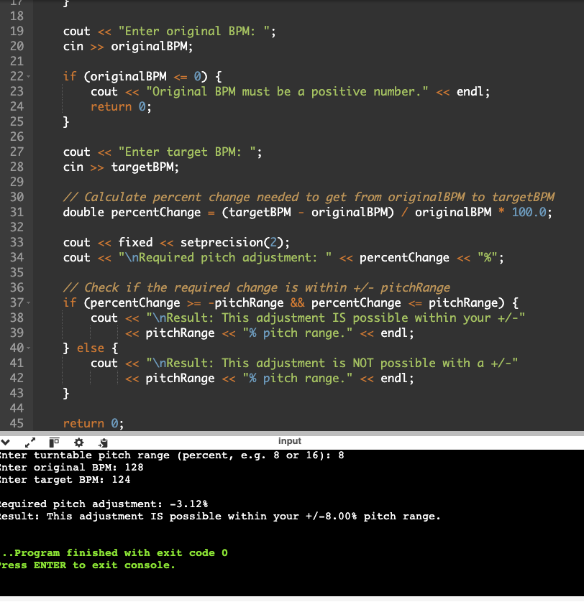
Side by side comparison

Slide 5
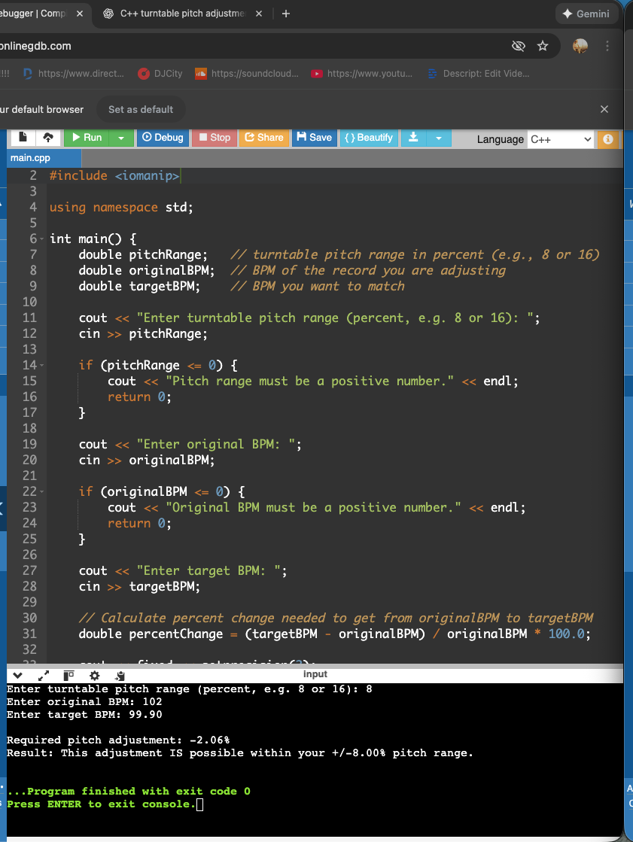

Slide 6
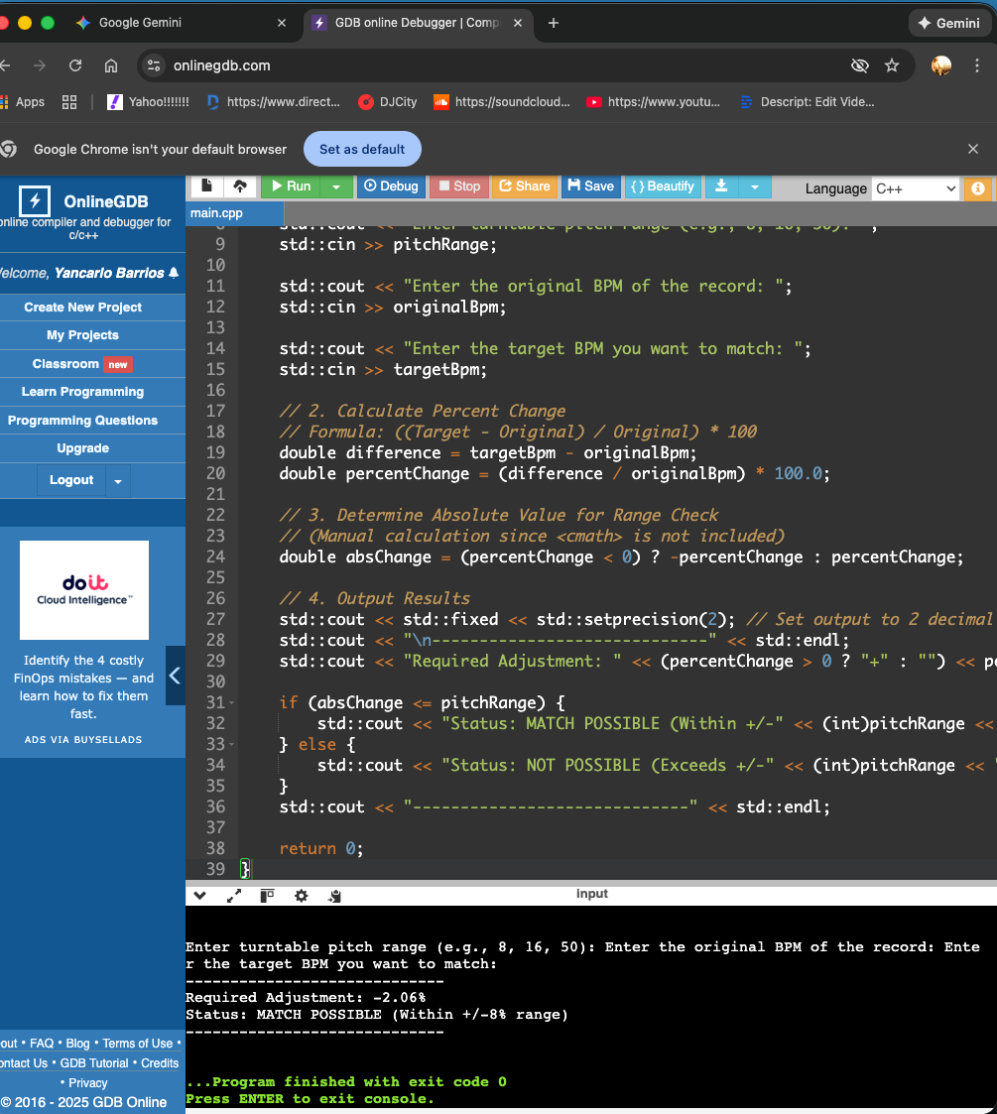
Gemini

Slide 7
Chat GPT Doo wop 102 bpm coversion

Slide 8
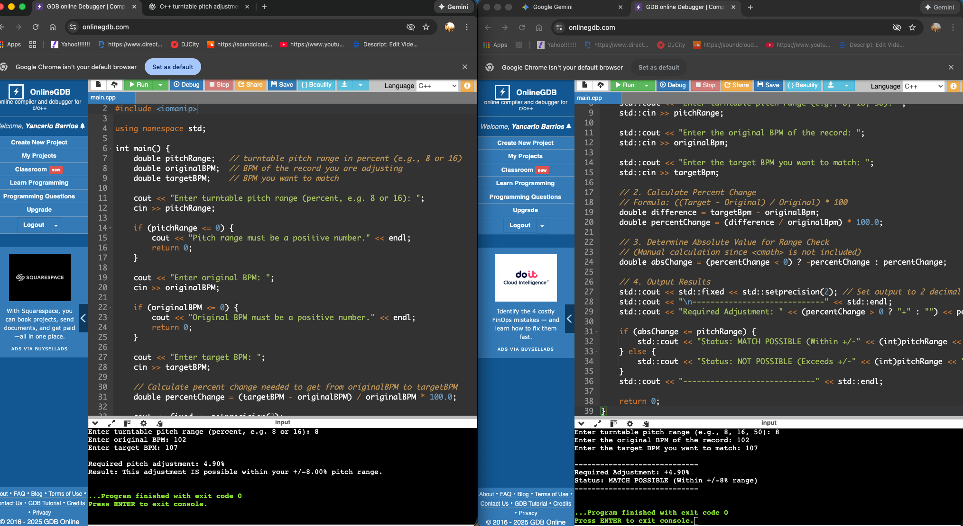
Kendrick Lamar side by side Gemini Vs Chat Gpt 102 bpm – 107 bpm

Slide 9
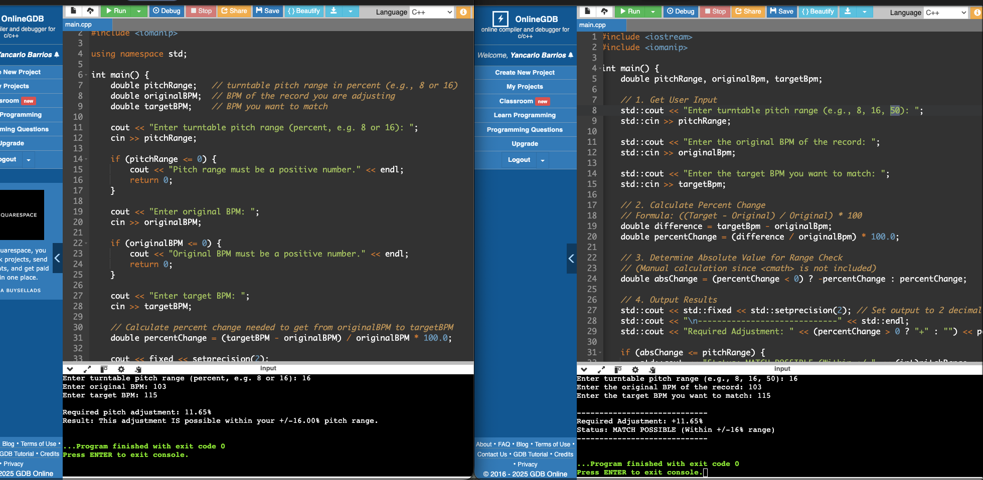
Side by Side Fail Test

